Slide 1
RISC-V Data Transfer
Slides: PDF

Slide 2
RV32I So Far
opname rd rs1 rs2
opname rd rs1 imm
add rd rs1 rs2 R[rd] = R[rs1] + R[rs2]
sub rd rs1 rs2 R[rd] = R[rs1] + R[rs2]
addi rd rs1 imm R[rd] = R[rs1] + imm
RV32I: RISC-V ISA variant: 32-bit, integer instructions
Verilog syntax:
R[rs1]: data in register rs1
Registers: x0 to x31
Immediates: constant values embedded into instruction (more later)

Slide 3
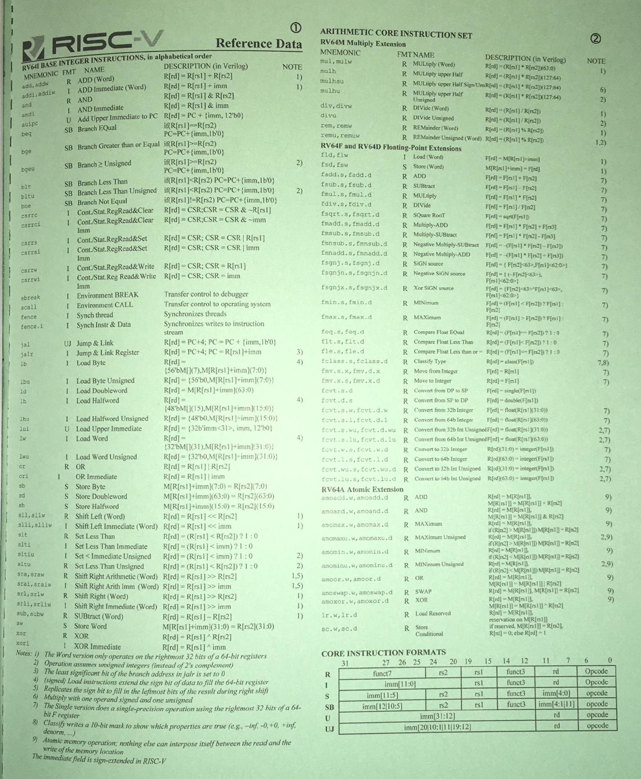
RISC-V Resources for CS61C
CS 61C Reference Card
https://cs61c.org/sp25/pdfs/resources/reference-card.pdf
Lists out the entire base architecture
Venus
https://venus.cs61c.org/
Online RISC-V simulator
Full Technical Specifications
https://lf-riscv.atlassian.net/wiki/spaces/HOME/pages/16154769/RISC-V+Technical+Specifications
→ Volume I: unprivileged ISA
🏡
At home: add’s bitwise operation is equivalent for both unsigned and signed integer addition (provided that “wraparound” happens on integer overflow)
RISC-V Green Card

Slide 4
Register Zero: Efficient Design
One particular immediate, the number zero (0),
appears very often in code.
RISC-V hardwires the register zero (x0) to value 0:
RISC-V add x3 x4 x0
C f = g;
RISC-V addi x3 x0 0xff
C f = 0xff;
Again, x0 is defined as zero in hardware.
add x0 x3 x4
This instruction a no-op: it won’t do anything!
Useful for pseudoinstructions.

Slide 5
Load Immediate: Pseudoinstruction
Pseudoinstructions are convenient instructions in RISC-V.
Not a “real” instruction, because we can use existing instructions to do the same thing.
When assembling to machine instructions, the assembler replaces pseudoinstructions with their real instruction counterpart.
Load Immediate:
li rd imm R[rd] = imm
Translated to real RISC-V instruction:
li x1 5 → addi x1 x0 5

Slide 6
[Review] Main Memory

Slide 7
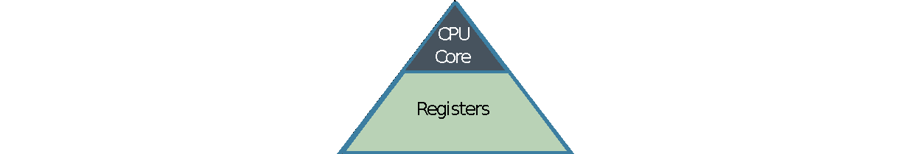
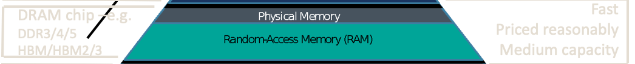
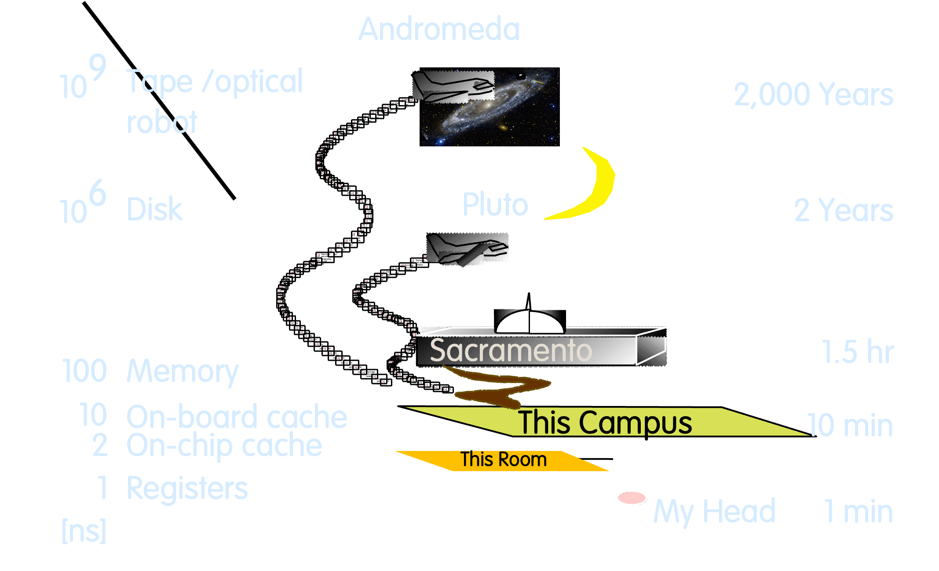
Why 32 registers? Tradeoffs of cost, speed
Processor chip
Extremely fast
Extremely expensive Tiny capacity
Storage Latency Analogy

Slide 8
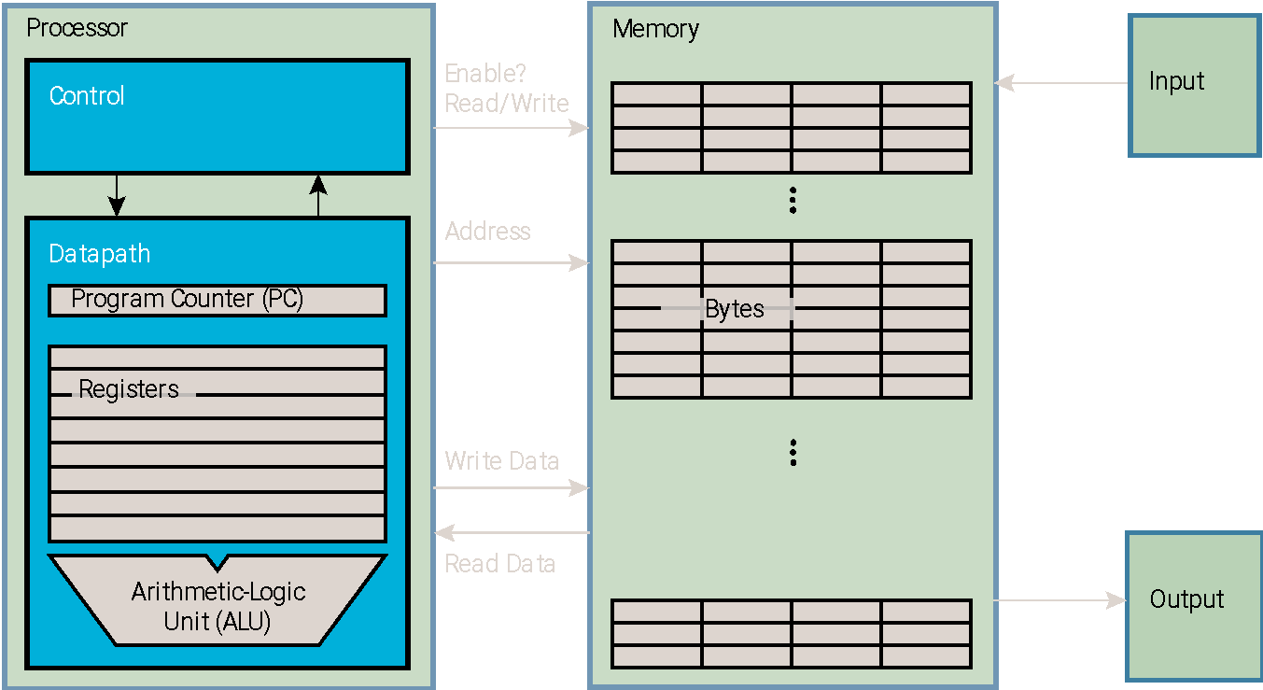
Data Transfer: Processor Operates on Registers
Slower than registers (50-500x slower), but much larger storage space (2-64GB on laptops)
Very fast (~.1ns), but limited space (32x4B =128B)
Processor-Memory Interface
I/O-Memory Interface

Slide 9
Memory on a 32-bit System
[review]
Modern machines are byte-addressable. 32-bit system:
2³² addressable memory bytes
32-bit address per byte
1 word is 4 bytes
 | +3 | +2 | +1 | +0
0x0
…
0x100 | 0xB0 | 0xBA | 0xCA | 0xFE
0x104 | 0x44 | 0x33 | 0x22 | 0x11
0x108 | 0x00 | 0x00 | 0x00 | 0x14
…
0xFFFFFFFC
RISC-V is little endian. To store 4-byte words:
Cut word into 4 bytes, store in consecutive addresses
Least significant byte gets lowest address.
By convention, word address is also lowest address.
0x100
0x104
0x108
0xB0BACAFE
0x44332211
20
arr
int arr[] = {0xB0BACAFE, 0x44332211, 20};

Slide 10
Data Transfer Instructions

Slide 11
Load from Memory, Store to Memory
RISC-V has instructions for moving data between memory and registers.
To perform operations on data, first load data from memory into registers.
When out of register space, store data to memory.
 | +3 | +2 | +1 | +0
…
0x100
…
load from
x4
store to
register
memory

Slide 12
Load from Memory: Load word
load from memory
Load word syntax:
lw rd imm(rs1)
R[rd] = M[R[rs1] + imm]
Means:
Compute address: R[rs1]+imm
Load 4 bytes from address into R[rd]
Terminology:
Base register: rs1
Offset: imm is a constant that must be known at assembly time

Slide 13
Load Word: Example
load from memory
Load word syntax:
lw rd imm(rs1) R[rd] = M[R[rs1] + imm]
Means:
Compute address: R[rs1]+imm
Load 4 bytes from address into R[rd]
Terminology:
Base register: rs1
Offset: imm is a constant that must be known at assembly time
 | +3 | +2 | +1 | +0
…
0x100 | 0xB0 | 0xBA | 0xCA | 0xFE
0x104 | 0x44 | 0x33 | 0x22 | 0x11
0x108 | 0x49 | 0x52 | 0x20 | 0x43
0x10C | 0x00 | 0x56 | 0x42 | 0x53
…
0x00
0x56
0x42
0x53
Example:
lw x10 12(x5)
x5
0x100
Compute address:
0x100 + 12
= 0x10C
x10
0x00564253
…

Slide 14
Store to Memory: Store word
store to memory
Store word syntax:
sw rs2 imm(rs1)
M[R[rs1] + imm] = R[rs2]
Means:
Compute address: R[rs1]+imm
Store 4 bytes of R[rs2] to address
Terminology:
Base register: rs1
Offset: imm is a constant that must be known at assembly time
Word alignment: R[rs1]+imm must be multiples of 4

Slide 15
Store word: Example
store to memory
Store word syntax:
sw rs2 imm(rs1) M[R[rs1] + imm] = R[rs2]
Means:
Compute address: R[rs1]+imm
Store 4 bytes of R[rs2] to address
Terminology:
Base register: rs1
Offset: imm is a constant that must be known at assembly time
Word alignment: R[rs1]+imm must be multiples of 4
 | +3 | +2 | +1 | +0
…
0x100 | 0xB0 | 0xBA | 0xCA | 0xFE
0x104 | 0x44 | 0x33 | 0x22 | 0x11
0x108 | 0x49 | 0x52 | 0x20 | 0x43
0x10C | 0x00 | 0x56 | 0x42 | 0x53
…
0x12
0x34
0x56
0x78
Example:
sw x10 0(x5)
x5
0x100
Compute address:
0x100 + 0
= 0x100
x10
0x12345678

Slide 16
Byte-level Data Transfer

Slide 17
Loading and Storing Bytes
In addition to word data transfers (lw, sw), RISC-V supports bytewise data transfers:
lb rd imm(rs1)
sb rs2 imm(rs1)
If registers are word-sized (4 bytes), how do we load/store only 1 byte?
Defined by RISC-V spec!

Slide 18
Store Byte
store to memory
For sb, we store the least significant byte.
 | +3 | +2 | +1 | +0
…
0x100 | 0xB0 | 0xBA | 0xCA | 0xFE
0x104 | 0x44 | 0x33 | 0x22 | 0x11
0x108 | 0x49 | 0x52 | 0x20 | 0x43
0x10C | 0x00 | 0x56 | 0x42 | 0x53
…
Example:
sb x10 0(x5)
0xEF
x5
Address 0x100 stores byte 0xEF.
0x100
x10
0x123456EF

Slide 19
Load Byte…?
load from memory
For lb, we load one byte into a register.
 | +3 | +2 | +1 | +0
…
0x100 | 0xB0 | 0xBA | 0xCA | 0xFE
0x104 | 0x44 | 0x33 | 0x22 | 0x11
0x108 | 0x49 | 0x52 | 0x20 | 0x43
0x10C | 0x00 | 0x56 | 0x42 | 0x53
…
Example:
lb x10 0(x5)
0xEF
Load byte 0xEF at address 0x100 into register.
x5
0x100
x10
?? ?? ?? EF
We must extend an 8-bit integer into a 32-bit integer. How?
Load byte operation depends on your integer representation: signed or unsigned.

Slide 20
Load Byte: Sign- and Zero-extending
Load byte depends on integer representation:
lb rd imm(rs1) # sign-extend
lbu rd imm(rs1) # zero-extend
lb: For signed numbers, sign-extend by filling top bits of register with the most significant bit (leftmost bit).
0xEF = –17 (base10)
0b1…111011111
0xFFFFFFEF
Sign extension: filling top bits with the most significant bit of a number.
lbu: For unsigned numbers, zero-extend by filling top bits of register with 0s.
0xEF = 239 (base10)
0b0…011011111
0x000000EF

Slide 21
Example

Slide 22
What is in x12?
li x11 0x93F5
sw x11 0(x5)
lb x12 1(x5)
 | +3 | +2 | +1 | +0
…
0x100 | 0xB0 | 0xBA | 0xCA | 0xFE
0x104 | 0x44 | 0x33 | 0x22 | 0x11
0x108 | 0x49 | 0x52 | 0x20 | 0x43
0x10C | 0x00 | 0x56 | 0x42 | 0x53
…
x5
0x0000 0100
x11
0xABCD EFAB
x12
0xCDEF ABCD
Gray: (random garbage)

Slide 23
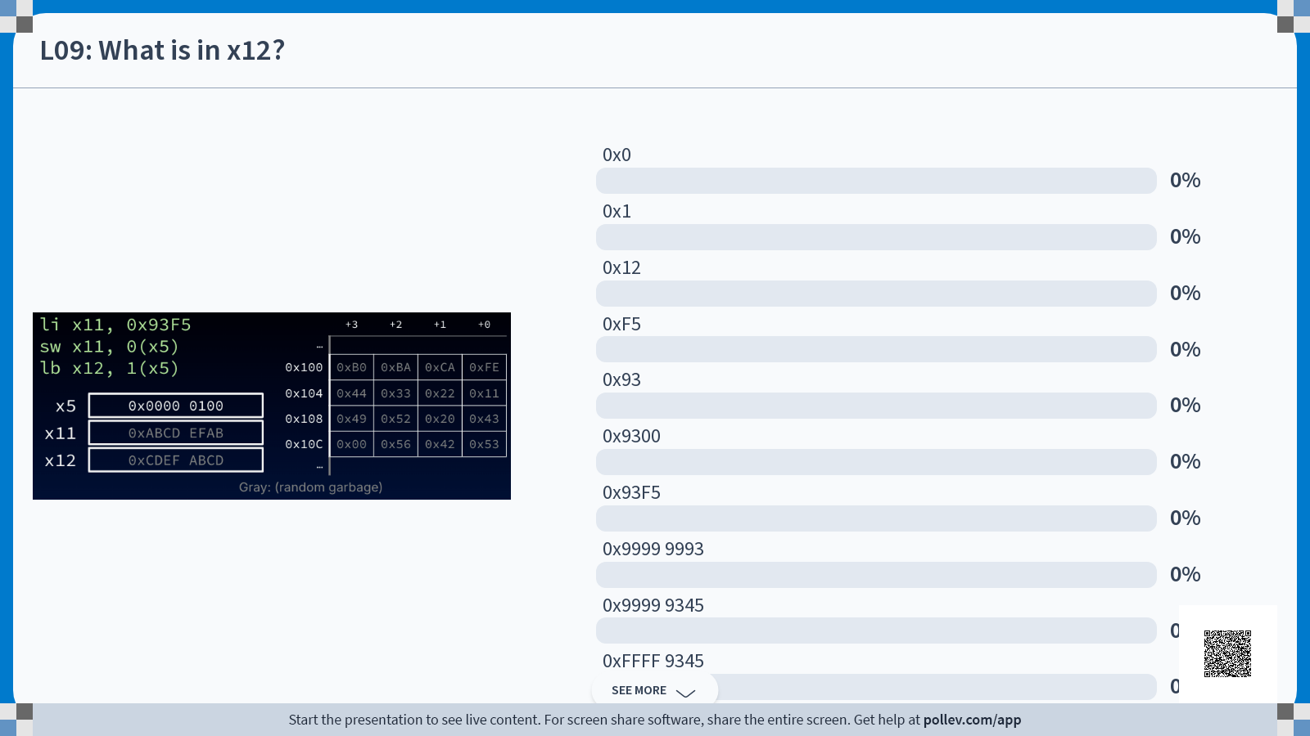
xor

Slide 24
What is in x12? Solution (1/3)
li x11 0x93F5
sw x11 0(x5)
lb x12 1(x5)
 | +3 | +2 | +1 | +0
…
0x100 | 0xB0 | 0xBA | 0xCA | 0xFE
0x104 | 0x44 | 0x33 | 0x22 | 0x11
0x108 | 0x49 | 0x52 | 0x20 | 0x43
0x10C | 0x00 | 0x56 | 0x42 | 0x53
…
x5
0x0000 0100
x11
0x0000 93F5
x12
0xCDEF ABCD
(li pseudoinstruction is actually addi x11 x0 0x93F5)
Gray: (random garbage)

Slide 25
What is in x12? Solution (2/3)
store to memory
li x11 0x93F5
sw x11 0(x5)
lb x12 1(x5)
 | +3 | +2 | +1 | +0
…
0x100 | 0xB0 | 0xBA | 0xCA | 0xFE
0x104 | 0x44 | 0x33 | 0x22 | 0x11
0x108 | 0x49 | 0x52 | 0x20 | 0x43
0x10C | 0x00 | 0x56 | 0x42 | 0x53
…
0x00
0x00
0x93
0xF5
x5
0x0000 0100
x11
0x0000 93F5
x12
0xCDEF ABCD
Address: 0x100 + 0 = 0x100
RV32I is little endian
Gray: (random garbage)

Slide 26
What is in x12? Solution (3/3)
load from memory
li x11 0x93F5
sw x11 0(x5)
lb x12 1(x5)
 | +3 | +2 | +1 | +0
…
0x100 | 0x00 | 0x00 | 0x93 | 0xF5
0x104 | 0x44 | 0x33 | 0x22 | 0x11
0x108 | 0x49 | 0x52 | 0x20 | 0x43
0x10C | 0x00 | 0x56 | 0x42 | 0x53
…
x5
0x0000 0100
x11
0x0000 93F5
x12
0xCDEF ABCD
0xFFFF FF93
Address: 0x100 + 1 = 0x101
Sign-extend: Top bit of 0x93 is 1, so fill top 24 bits with 1s
0x93 = 0b1001 0011 → 0b1…1 1001 0011 → 0xFFFF FF93
Gray: (random garbage)

Slide 27
Long Example: Stack Pointer, Register Names
For a written walkthrough, check Ed (#173bf).

Slide 28
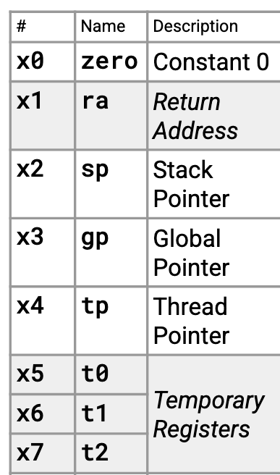
Converting C code to RISC-V
If we have too many words to fit into registers, we must use memory.
Let’s translate a C program with the following restrictions:
Modify ONLY x5, x6, and x7
Register names: t0, t1, t2, respectively, i.e., temporary registers 0-2
Assume x2 points to the start of a block of memory on the stack that we can use however
Register name: sp, for stack pointer
(yes, THAT stack pointer!)
RISC-V calling convention gives common names/usage to each register. See refcard!

Slide 29
Example (1/10): Stack Frame
int a = 5;
char b[] = "string"; // Array will get stored on stack
int c[10];
uint8_t d = b[3];
c[4] = a+d;
c[a] = 20;
a: 0(sp)
b: 4(sp)
c: 12(sp)
d: 52(sp)
First, assign each variable to some offset from our stack pointer sp.
Analogous to local variables in stack frame
Exact addresses don’t matter, so long as we’re consistent

Slide 30
Example (2/10): Initialize integer
a: 0(sp) c: 12(sp)
b: 4(sp) d: 52(sp)
int a = 5;
char b[] = "string";
int c[10];
uint8_t d = b[3];
c[4] = a+d;
c[a] = 20;
1
2
li t0 5
sw t0 0(sp)
t0
0x0000 0005
 | +3 | +2 | +1 | +0
0(sp) | 00 | 00 | 00 | 05
4(sp) | FA | CE | FA | CE
8(sp) | FA | CE | FA | CE
12(sp) | FA | CE | FA | CE
16(sp) | FA | CE | FA | CE
Gray: (random garbage)

Slide 31
Example (3/10): Initialize string?
a: 0(sp) c: 12(sp)
b: 4(sp) d: 52(sp)
int a = 5;
char b[] = "string";
int c[10];
uint8_t d = b[3];
c[4] = a+d;
c[a] = 20;
3
4
5
6
7
8
li t0 0x73
sb t0 4(sp)
li t0 0x74
sb t0 5(sp)
li t0 0x72
sb t0 6(sp)
9
10
11
12
13
14
15
li t0 0x69
sb t0 7(sp)
li t0 0x6E
sb t0 8(sp)
li t0 0x67
sb t0 9(sp)
sb x0 10(sp)
's' | 't' | 'r' | 'i' | 'n' | 'g' | '\0'
73 | 74 | 72 | 69 | 6E | 67 | 00
 | +3 | +2 | +1 | +0
0(sp) | 00 | 00 | 00 | 05
4(sp)
8(sp) | FA
12(sp) | FA | CE | FA | CE
16(sp) | FA | CE | FA | CE
ASCII (0x)
69
72
74
73
00
67
6E
Seems costly!
Can we do better?
Gray: (random garbage)

Slide 32
Example (4/10): String, better
a: 0(sp) c: 12(sp)
b: 4(sp) d: 52(sp)
int a = 5;
char b[] = "string";
int c[10];
uint8_t d = b[3];
c[4] = a+d;
c[a] = 20;
3
4
5
6
li t0 0x69727473
sw t0 4(sp)
li t1 0x0000676E
sw t1 8(sp)
t0
0x6972 7473
t1
0x0000 676E
t2
's' | 't' | 'r' | 'i' | 'n' | 'g' | '\0'
73 | 74 | 72 | 69 | 6E | 67 | 00
 | +3 | +2 | +1 | +0
0(sp) | 00 | 00 | 00 | 05
4(sp)
8(sp)
12(sp) | FA | CE | FA | CE
16(sp) | FA | CE | FA | CE
ASCII (0x)
69
72
74
73
00
00
67
6E
Gray: (random garbage)

Slide 33
Example (5/10): String, better
a: 0(sp) c: 12(sp)
b: 4(sp) d: 52(sp)
int a = 5;
char b[] = "string";
int c[10];
uint8_t d = b[3];
c[4] = a+d;
c[a] = 20;
3
4
5
6
li t0 0x69727473
sw t0 4(sp)
li t1 0x0000676E
sw t1 8(sp)
t0
0x6972 7473
t1
0x0000 676E
t2
's' | 't' | 'r' | 'i' | 'n' | 'g' | '\0'
73 | 74 | 72 | 69 | 6E | 67 | 00
 | +3 | +2 | +1 | +0
0(sp) | 00 | 00 | 00 | 05
4(sp)
8(sp)
12(sp) | FA | CE | FA | CE
16(sp) | FA | CE | FA | CE
ASCII (0x)
4B integer
69
72
74
0x69727473
0x0000676E
73
00
00
67
LSB, 's'
zero pad
6E
Strings are character byte arrays
Store by 4-byte words, but note little endian
Gray: (random garbage)

Slide 34
Example (6/10): Declare array
a: 0(sp) c: 12(sp)
b: 4(sp) d: 52(sp)
int a = 5;
char b[] = "string";
int c[10];
uint8_t d = b[3];
c[4] = a+d;
c[a] = 20;
 | +3 | +2 | +1 | +0
0(sp) | 00 | 00 | 00 | 05
4(sp) | 69 | 72 | 74 | 73
8(sp) | 00 | 00 | 67 | 6E
12(sp) | FA | CE | FA | CE
16(sp) | FA | CE | FA | CE
No data moves between registers and memory!
No instructions needed—leave things as-is!
Gray: (random garbage)

Slide 35
Example (7/10): Load/store byte
a: 0(sp) c: 12(sp)
b: 4(sp) d: 52(sp)
int a = 5;
char b[] = "string"; int c[10]
uint8_t d = b[3];
c[4] = a+d;
c[a] = 20;
7
8
lb t0 7(sp)
sb t0 52(sp)
t0
0x0000 0069
 | +3 | +2 | +1 | +0
0(sp) | 00 | 00 | 00 | 05
4(sp) | 69 | 72 | 74 | 73
8(sp) | 00 | 00 | 67 | 6E
… | …
52(sp) | FA | CE | FA | 69
Gray: (random garbage)

Slide 36
Example (8/10): Constant array index
a: 0(sp) c: 12(sp)
b: 4(sp) d: 52(sp)
int a = 5;
char b[] = "string";
int c[10];
uint8_t d = b[3];
c[4] = a+d;
c[a] = 20;
9
10
11
12
lw t0 0(sp)
lbu t1 52(sp)
add t2 t0 t1
sw t2 28(sp)
t0
0x0000 0005
t1
0x0000 0069
t2
0x0000 006E
 | +3 | +2 | +1 | +0
0(sp) | 00 | 00 | 00 | 05
4(sp) | 69 | 72 | 74 | 73
… | …
28(sp) | 00 | 00 | 00 | 6E
… | …
52(sp) | FA | CE | FA | 69
Offset from sp
+12
+16
+20
+24
+28
+32
c[0] | c[1] | c[2] | c[3] | c[4] | c[5]
Pointer arithmetic: 4*sizeof(int) = 16
16 bytes after 12(sp) → 28(sp)

Slide 37
Example (9/10): Variable array index
a: 0(sp) c: 12(sp)
b: 4(sp) d: 52(sp)
int a = 5;
char b[] = "string";
int c[10];
uint8_t d = b[3];
c[4] = a+d;
c[a] = 20;
13
14
15
16
17
18
li t0 20
lw t1 0(sp)
slli t1 t1 2
addi t1 t1 12
add t1 t1 sp
sw t0 0(t1)
t0
0x0000 0014
t1
0x0000 0005
L14
0x0000 0005
0x0000 0014
L15
0x0000 0014
L16
0x0000 0020
Offset from sp
L17
+12
+16
+20
+24
+28
+32
(sp+32)
c[0] | c[1] | c[2] | c[3] | c[4] | c[5]
L18: sw t0 0(t1)
t0: data to store
t1: address to store at
t1: (t1*4)+12+sp
L14-15: Scale a by 4 (bit shift left 2)
L16-17: Add offset to address of c

Slide 38
Example (10/10): Full Code
1
2
3
4
5
6
int a = 5;
char b[] = "string";
int c[10];
uint8_t d = b[3];
c[4] = a+d;
c[a] = 20;
1
2
3
4
5
6
7
8
9
10
11
12
13
14
15
16
17
18
li t0 5
sw t0 0(sp)
li t0 0x69727473
sw t0 4(sp)
li t1 0x0000676E
sw t1 8(sp)
lb t0 7(sp)
sb t0 52(sp)
lw t0 0(sp)
lbu t1 52(sp)
add t2 t0 t1
sw t2 28(sp)
li t0 20
lw t1 0(sp)
slli t1 t1 2
addi t1 t1 12
add t1 t1 sp
sw t0 0(t1)
a: 0(sp)
b: 4(sp)
c: 12(sp)
d: 52(sp)

Slide 39
[Extra] Short Example 2

Slide 40
Translate *x = *y;
We want to translate *x = *y into RISC-V.
x, y int *ptrs stored in: x3 x5
1: add x3 x5 zero
2: add x5 x3 zero
3: lw x3 0(x5)
4: lw x5 0(x3)
5: lw x8 0(x5)
6: sw x8 0(x3)
7: lw x5 0(x8)
8: sw x3 0(x8)
A. 1
B. 2
C. 3
D. 4
E. 5 → 6
F. 6 -> 5
G. 7 → 8
H. Something else

